Slide 1

Multivariate regression
Geog4300/6300
Jerry Shannon

Slide 2
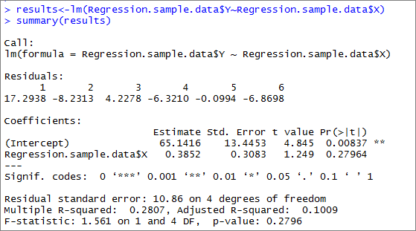
Sometimes, one variable isn’t enough.

Slide 3
Two reasons for using multivariate regression 1. Because more than one independent variable might be relevant.
What is the effect of both garage size and # of bathrooms on home prices?
How do both temperature and precipitation influence the presence of a particular tree species?
2. Because you want to rule out (or “control for”) other factors.
How does race predict educational achievement independent of social class?
How does corn production influence humidity independent of precipitation patterns?

Slide 4
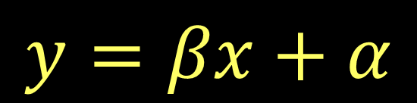
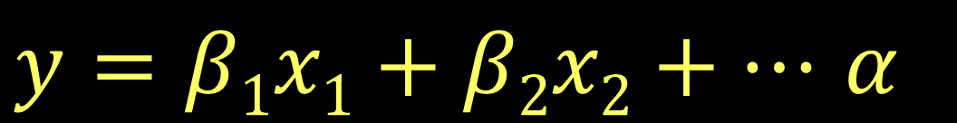
If simple regression is shown in this equation:
Multiple regression is shown by this one:
Just like simple regression, multiple regression seeks the line with the best fit.

Slide 5
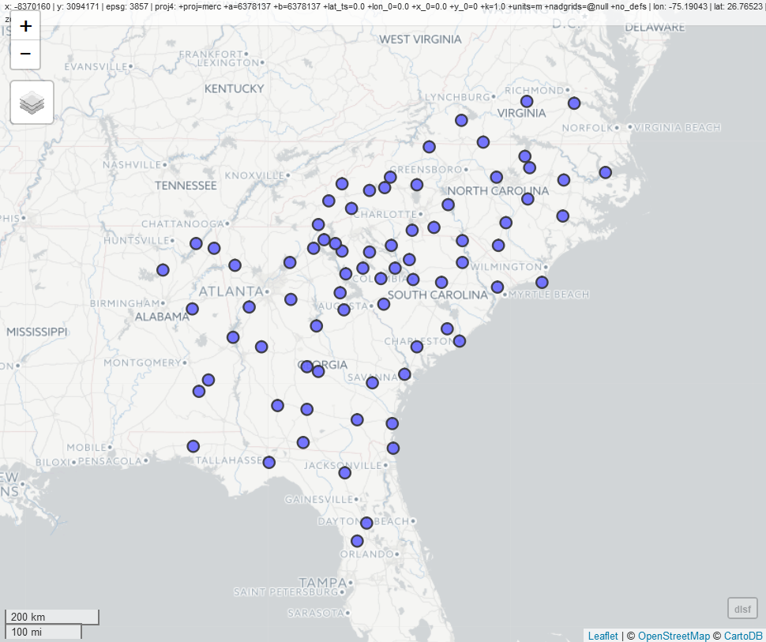
An example:
What’s the best predictor of the date of the last frost in the spring?

Slide 6
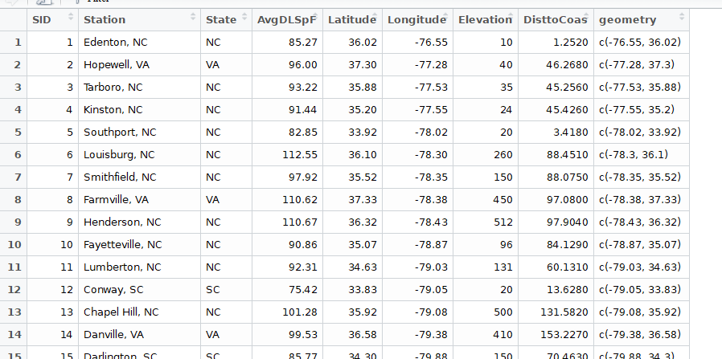
Three predictors:
Latitude
Elevation
Distance to the coast

Slide 7
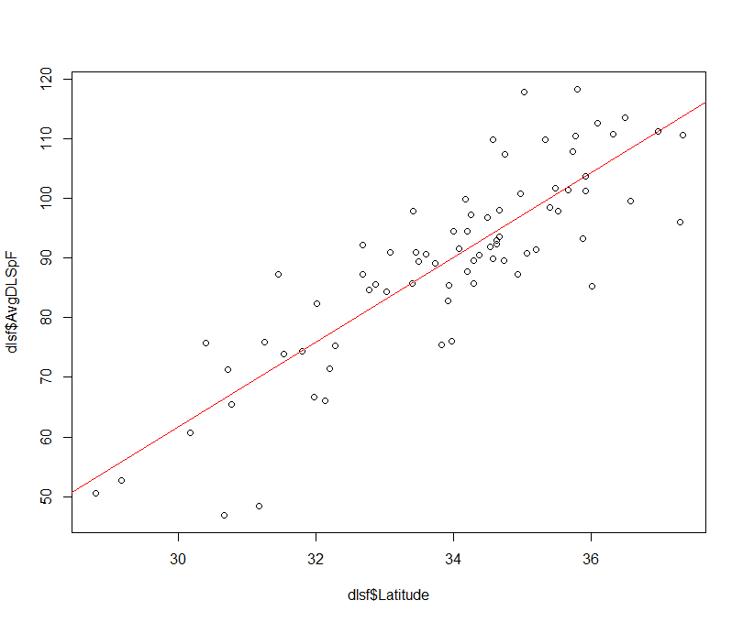
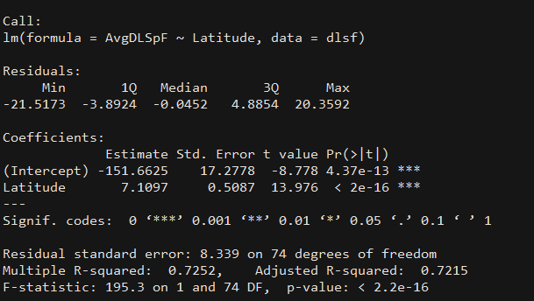
Three predictors:
Latitude
Elevation
Distance to the coast

Slide 8
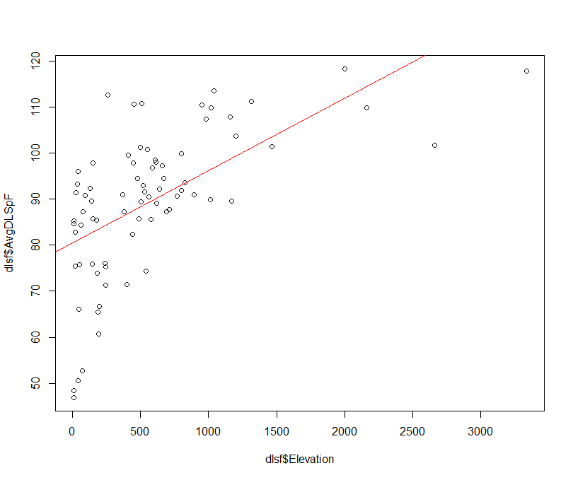
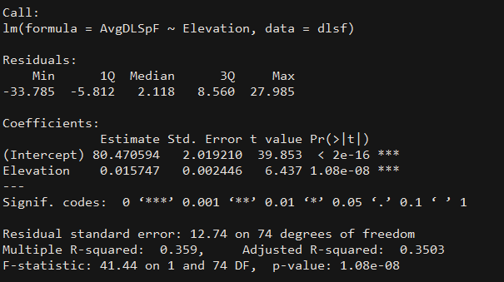
Three predictors:
Latitude
Elevation
Distance to the coast

Slide 9
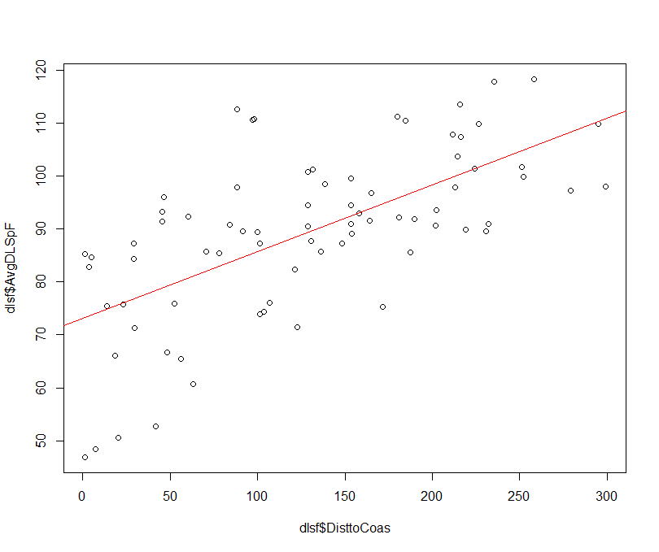
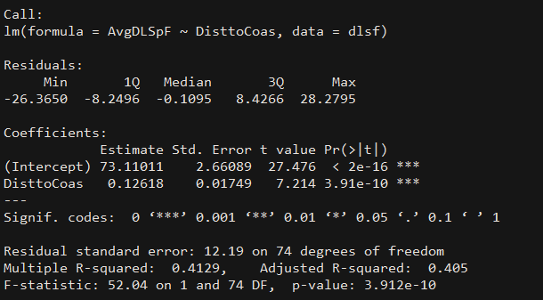
Three predictors:
Latitude
Elevation
Distance to the coast

Slide 10
 |  | Model 1 | Model 2 | Model 3
Latitude | Coeff. | 7.11***
 | SE | 0.51
Elevation | Coeff.
 | SE
Dist to Coast | Coeff.
 | SE
Model R2 |  | 0.7252
Adjusted R2 |  | 0.7215
What happens when we gradually add more variables in?

Slide 11
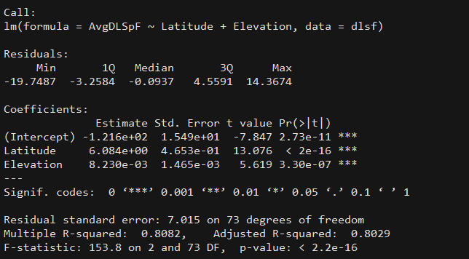
 |  | Model 1 | Model 2 | Model 3
Latitude | Coeff. | 7.11*** | 6.08***
 | SE | 0.51 | 0.47
Elevation | Coeff. |  | 0.008***
 | SE |  | 0.0015
Dist to Coast | Coeff.
 | SE
Model R2 |  | 0.7252 | 0.8082
Adjusted R2 |  | 0.7215 | 0.8029
What happens when we gradually add more variables in?

Slide 12
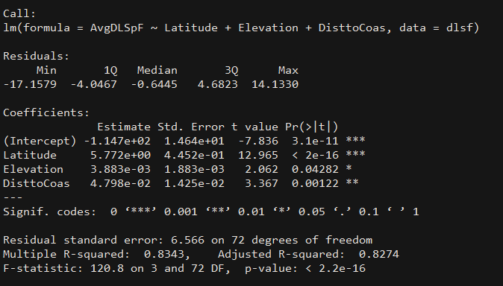
 |  | Model 1 | Model 2 | Model 3
Latitude | Coeff. | 7.11*** | 6.08*** | 5.78***
 | SE | 0.51 | 0.47 | 0.45
Elevation | Coeff. |  | 0.008*** | 0.004*
 | SE |  | 0.002 | 0.002
Dist to Coast | Coeff. |  |  | 0.05**
 | SE |  |  | 0.004
Model R2 |  | 0.7252 | 0.8082 | 0.8343
Adjusted R2 |  | 0.7215 | 0.8029 | 0.8274
What happens when we gradually add more variables in?

Slide 13
 |  | Model 1 | Model 2 | Model 3
Latitude | Coeff. | 7.11*** | 6.08*** | 5.78***
 | SE | 0.51 | 0.47 | 0.45
Elevation | Coeff. |  | 0.008*** | 0.004*
 | SE |  | 0.002 | 0.002
Dist to Coast | Coeff. |  |  | 0.05**
 | SE |  |  | 0.004
Model R2 |  | 0.7252 | 0.8082 | 0.8343
Adjusted R2 |  | 0.7215 | 0.8029 | 0.8274
Latitude stays positive and significant, but its magnitude declines when other variables are added.

Slide 14
 |  | Model 1 | Model 2 | Model 3
Latitude | Coeff. | 7.11*** | 6.08*** | 5.78***
 | SE | 0.51 | 0.47 | 0.45
Elevation | Coeff. |  | 0.008*** | 0.004*
 | SE |  | 0.002 | 0.002
Dist to Coast | Coeff. |  |  | 0.05**
 | SE |  |  | 0.004
Model R2 |  | 0.7252 | 0.8082 | 0.8343
Adjusted R2 |  | 0.7215 | 0.8029 | 0.8274
Latitude stays positive and significant, but its magnitude declines when other variables are added.
All variables are significant in the final model. R2 and adjusted R2 increases for each one.

Slide 15
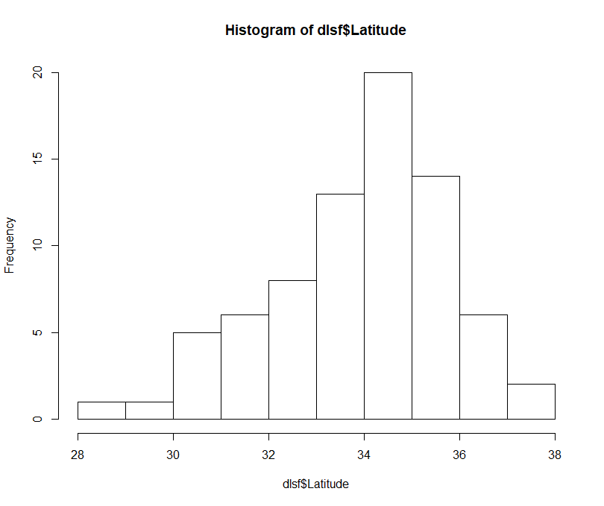
 |  | Model 1 | Model 2 | Model 3
Latitude | Coeff. | 7.11*** | 6.08*** | 5.78***
 | SE | 0.51 | 0.47 | 0.45
Elevation | Coeff. |  | 0.008*** | 0.004*
 | SE |  | 0.002 | 0.002
Dist to Coast | Coeff. |  |  | 0.05**
 | SE |  |  | 0.004
Model R2 |  | 0.7252 | 0.8082 | 0.8343
Adjusted R2 |  | 0.7215 | 0.8029 | 0.8274
Latitude stays positive and significant, but its magnitude declines when other variables are added.
All variables are significant in the final model. R2 and adjusted R2 increases for each one.
Assessing magnitude:
Latitude

Slide 16
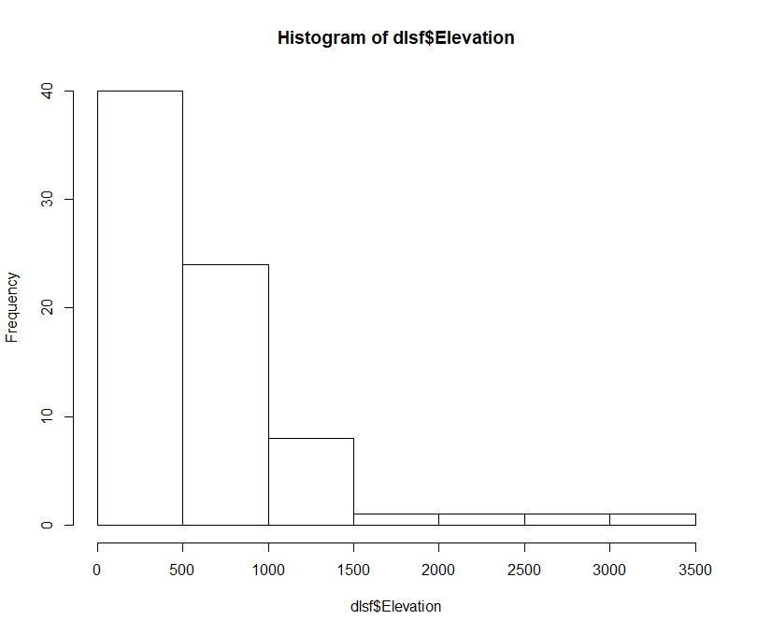
 |  | Model 1 | Model 2 | Model 3
Latitude | Coeff. | 7.11*** | 6.08*** | 5.78***
 | SE | 0.51 | 0.47 | 0.45
Elevation | Coeff. |  | 0.008*** | 0.004*
 | SE |  | 0.002 | 0.002
Dist to Coast | Coeff. |  |  | 0.05**
 | SE |  |  | 0.004
Model R2 |  | 0.7252 | 0.8082 | 0.8343
Adjusted R2 |  | 0.7215 | 0.8029 | 0.8274
Latitude stays positive and significant, but its magnitude declines when other variables are added.
All variables are significant in the final model. R2 and adjusted R2 increases for each one.
Assessing magnitude:
Elevation

Slide 17
 |  | Model 1 | Model 2 | Model 3
Latitude | Coeff. | 7.11*** | 6.08*** | 5.78***
 | SE | 0.51 | 0.47 | 0.45
Elevation | Coeff. |  | 0.008*** | 0.004*
 | SE |  | 0.002 | 0.002
Dist to Coast | Coeff. |  |  | 0.05**
 | SE |  |  | 0.004
Model R2 |  | 0.7252 | 0.8082 | 0.8343
Adjusted R2 |  | 0.7215 | 0.8029 | 0.8274
Latitude stays positive and significant, but its magnitude declines when other variables are added.
All variables are significant in the final model. R2 and adjusted R2 increases for each one.
Assessing magnitude:
Distance to Coast

Slide 18
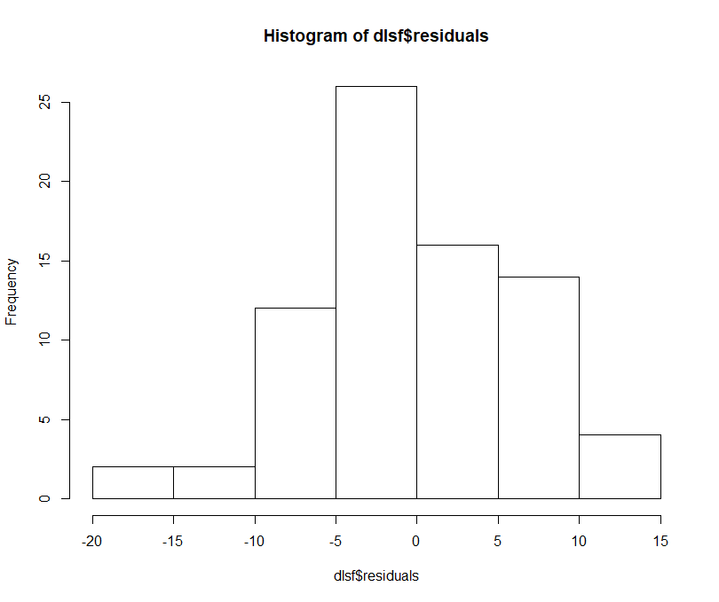
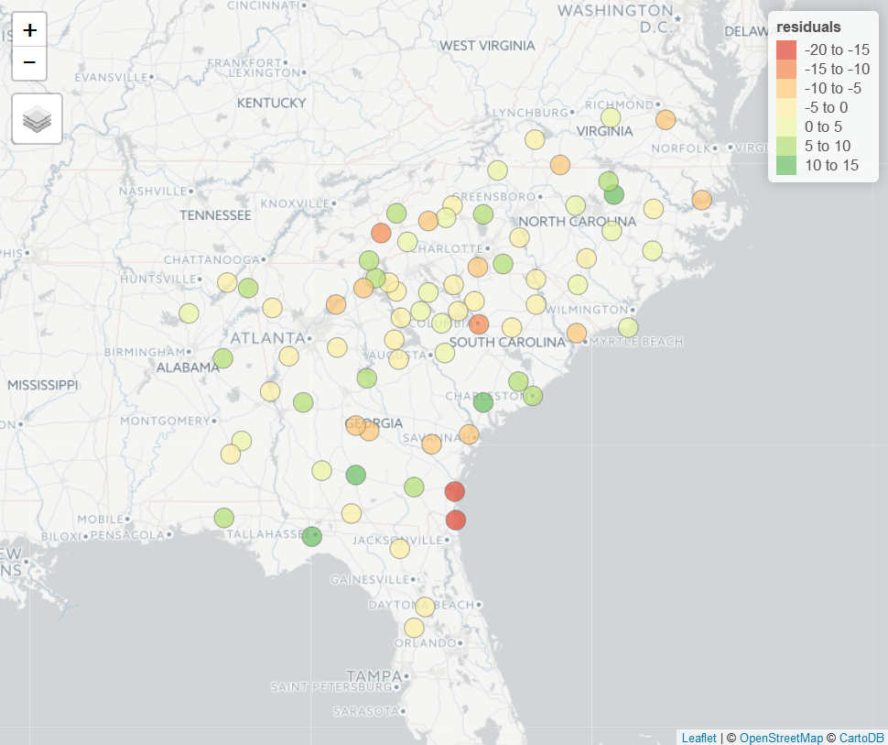
Diagnostics: Residuals

Slide 19
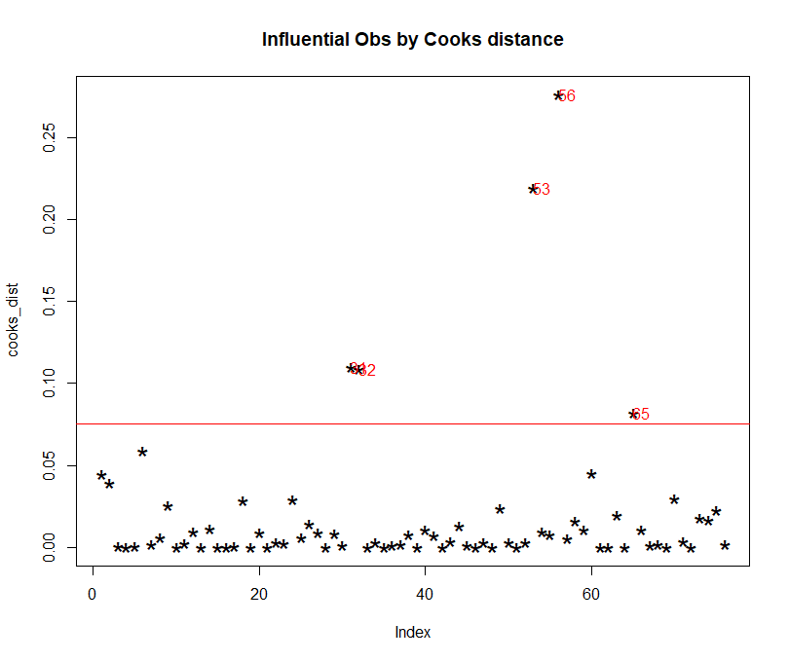
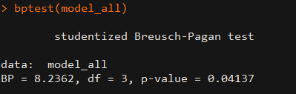
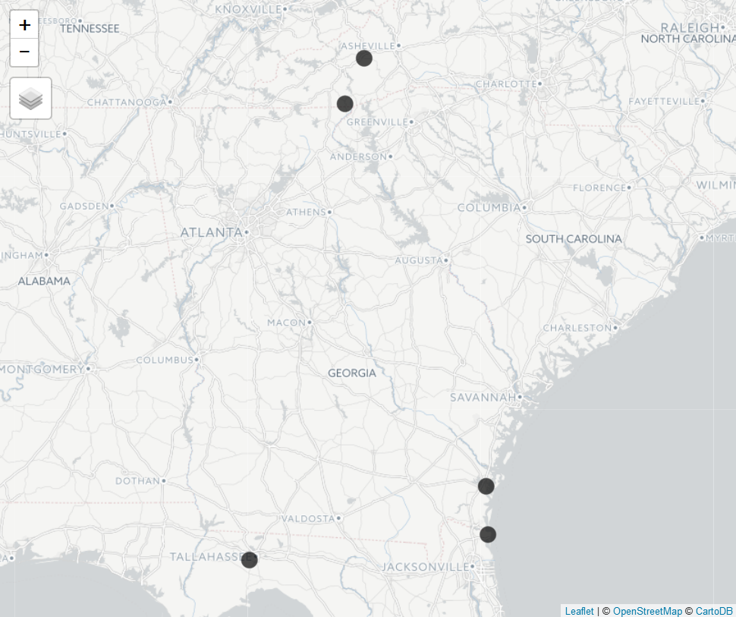
Diagnostics: Outliers & heteroskedasticity

Slide 20
Which variables should you include in your model?
What do previous theories say?
What are the results of past research?
Variables are often added in groups (climate related, population density, etc.)

Slide 21
Watch out for multicollinearity!
When two variables are closely correlated, they can bias the model. Tests like VIF can diagnose this, or just create a correlation matrix with your independent variables.

Slide 22
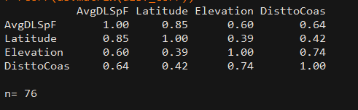
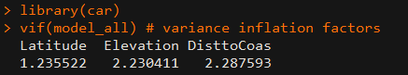
Correlation and our variables
Variance Inflation Factor (VIF)
Higher is worse. Ideally < 4 or 5.

Slide 23
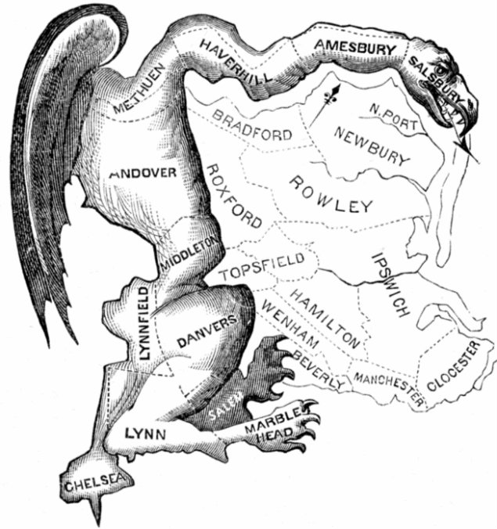
You try it!
Continuing work on Lab 7

Slide 24
You try it!
Dataset: County social characteristics: ACSCtyData_2014ACS
CSV File
What predicts % of native born households with health insurance (nat_ins_pct)?
% white (wht_pop_pct)
% with HS diploma only (HSGrad_pct)
% in poverty (pov_pop_pct)
Model each variable separately, then together.
Check model diagnostics

